Slide 1
Predicting Injury Outcomes of Traffic Accidents in Orange County, Florida
Group 3:
Rhea Nibert, Ava Nafisi, Jordan Allwood, Meghana Mukkoti, Shivani Ananth

Slide 2
INTRODUCTION

Slide 3
OVERVIEW
Around 1.19 million people die in traffic accidents each year
Between 20 and 50 million more people suffer injuries
Understanding the factors that lead to these injuries can help improve road safety
Our analysis is focused on Orange County, Florida
Source:
https://www.who.int/news-room/fact-sheets/detail/road-traffic-injuries

Slide 4
OBJECTIVES
Identify key factors that influence injury outcomes in traffic accidents
Develop predictive models to classify accidents as either causing minor injuries, major injuries, fatal injuries, or no injuries.
Provide insights that can inform policymakers, law enforcement, and insurance companies to improve road safety and accident prevention strategies

Slide 5
MODEL STRUCTURE
We aim to build machine learning models that take this form:
Input: Traffic accident report features (e.g., weather conditions, road type, time of day, vehicle speed, driver conditions)
Output: Predicted injury severity level (0 = No injuries, 1 = Nonfatal injuries, 2 = Severe injuries, 3 = Fatalities).

Slide 6
DATA PREPARATION

Slide 7
OUR DATA
Acquired from FDOT’s State Safety Office Geographic Information System (SSOGIS)
Includes all Orange County traffic accidents in 2020
More than 12000 accidents with over 100 features recorded about each one
Feature engineering will be a key challenge

Slide 8
DATA CLEANING
Removed redundant features and kept only ones with predictive power - narrowed it down to 50
Renamed categorical levels for clarity
Grouped levels that appeared in less 0.1% of the data into an “Other/Unknown” level
Imputed missing values and removed columns where more than 10% were missing

Slide 9
RESPONSE VARIABLE
Dataset initially contained 3 separate columns for injury: Count of Nonfatal Injuries, Count of Severe Injuries, Count of Traffic Fatalities
We created a single integer column named Highest Degree of Injury using the following strategy:
0 = No injuries
1 = Nonfatal injuries
2 = Severe injuries
3 = Fatalities
If multiple injury types occur in an accident, we assigned the highest severity level.

Slide 10
INITIAL FEATURE SELECTION
We narrowed our dataset down to 50 features, but this was still a lot to work with.
Employed a Random Forest model to narrow our selection down to the 20 most important features
Scaled numeric variables and Target Encoded categorical variables - replace category levels with the mean value of the response variable for that category

Slide 11
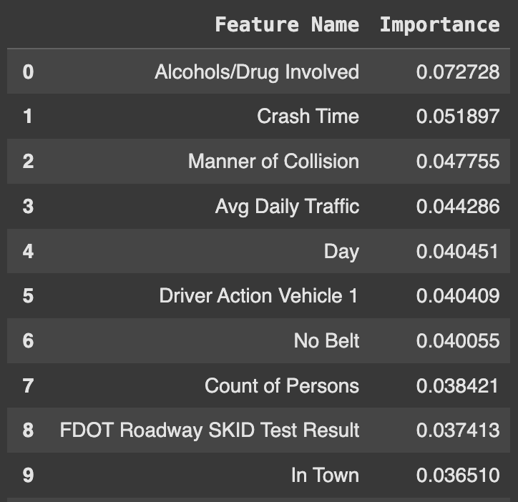
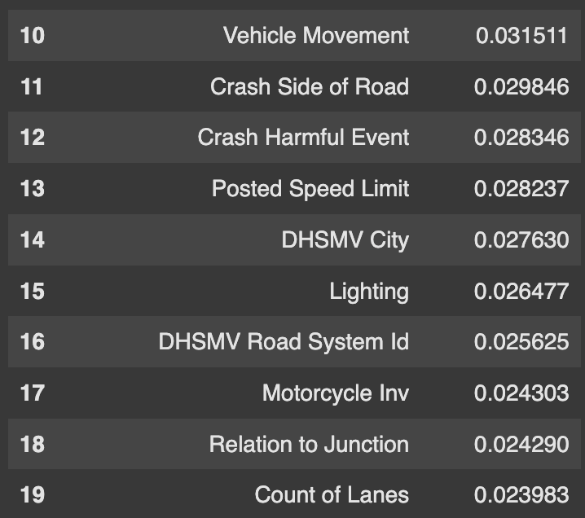
SELECTED FEATURES

Slide 12
DATA VISUALIZATION

Slide 13
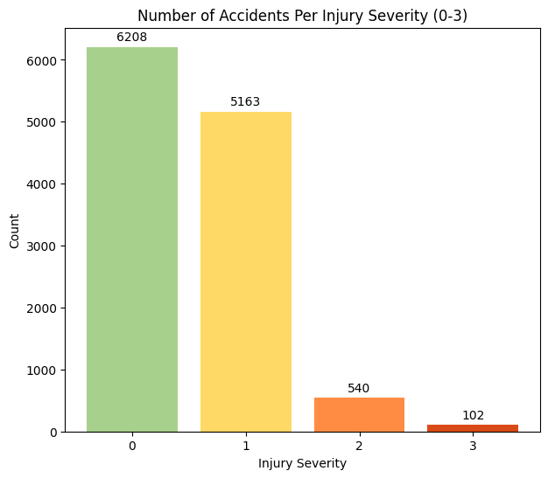
INJURY SEVERITY
We want to have an understanding of the distribution of our response variable.
While classes don’t need to be perfectly balanced, machine learning models often develop a bias toward majority classes
It’s clear there’s a major class imbalance, especially Nonfatal Injuries (Class 1) to Severe Injuries (Class 2) and Fatalities (Class 3).
We may need to consider methods to balance our classes for our modeling.

Slide 14
PROPORTIONAL BARCHARTS
Stacked bar charts are good for getting a look at the proportions of each class in different categorical levels of the predictors.
Bar shows showing the average value of the predictor in each variable level accomplish a similar goal.
If there is significant variance in the injury level among category levels, this means this category is a good predictor.
We’ll share some of our most meaningful bar charts.

Slide 15
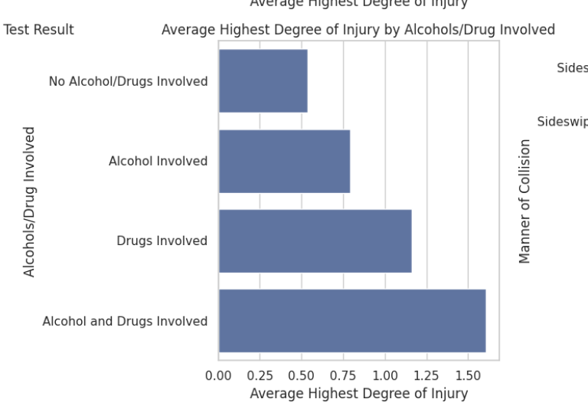
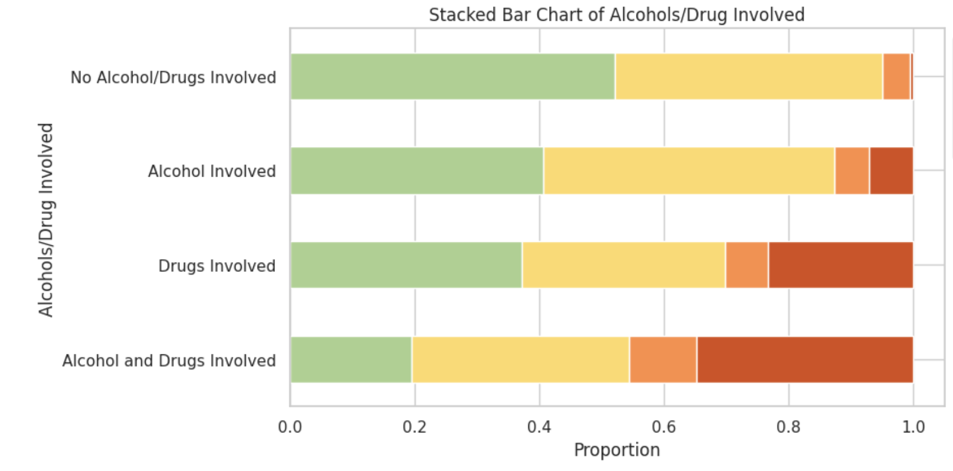
PROPORTIONAL BARCHARTS
Alcohol/Drugs Involved: Accidents with impaired drivers resulted in significantly higher degrees of injury.

Slide 16
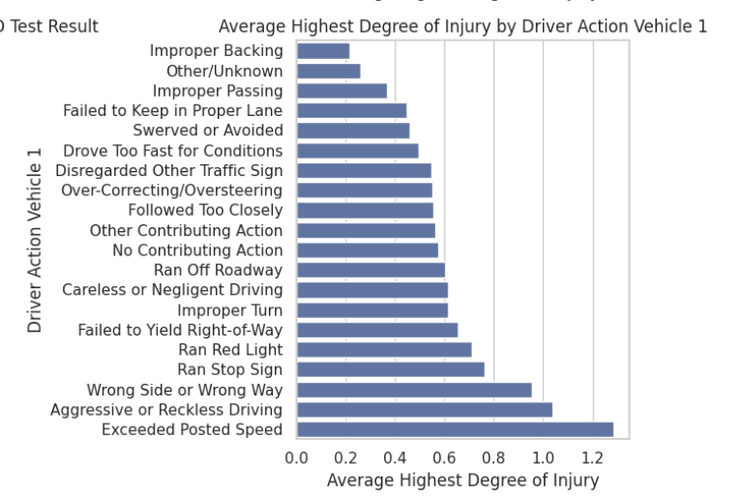
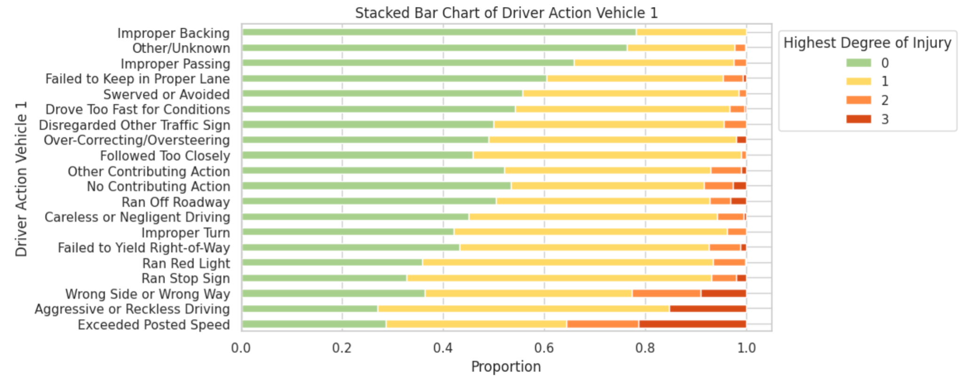
PROPORTIONAL BARCHARTS
Driver Action: Accidents involving drivers who exceeded the speed limit, engaged in reckless driving, or drove the wrong way resulted in the highest average degree of injury.

Slide 17
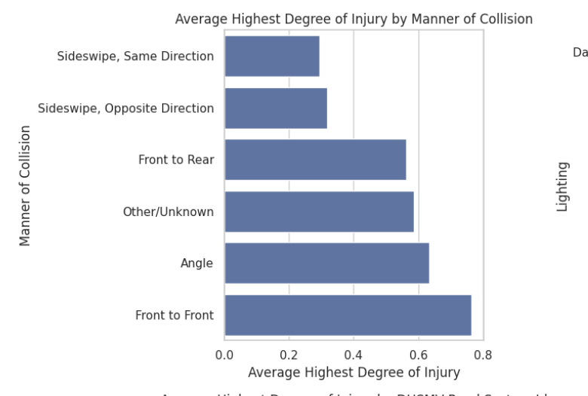
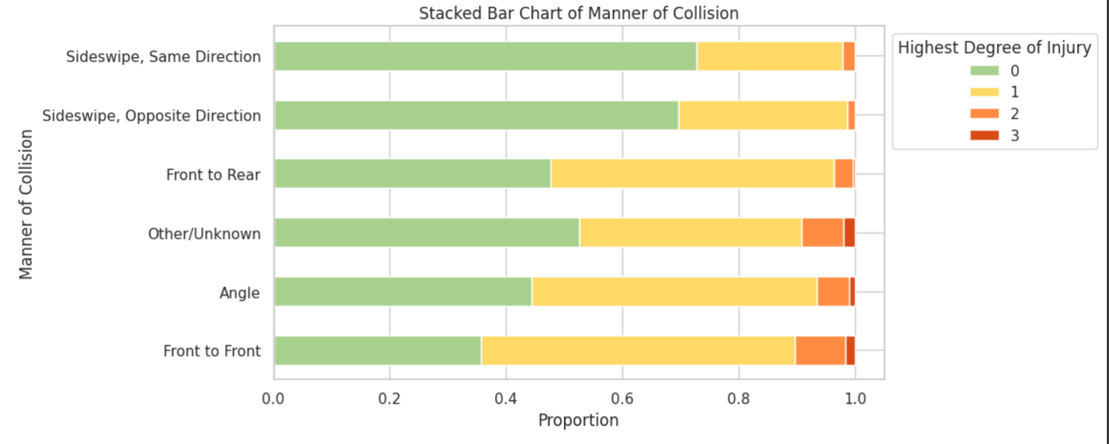
PROPORTIONAL BARCHARTS
Manner of Collision: Front-to-Front accidents resulted in the average highest degree of injury.

Slide 18
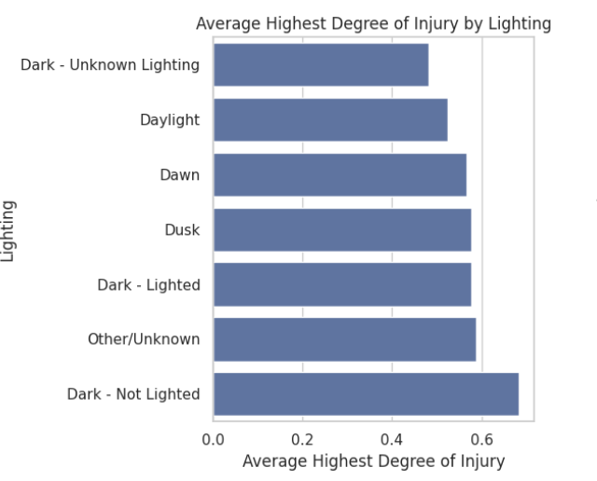
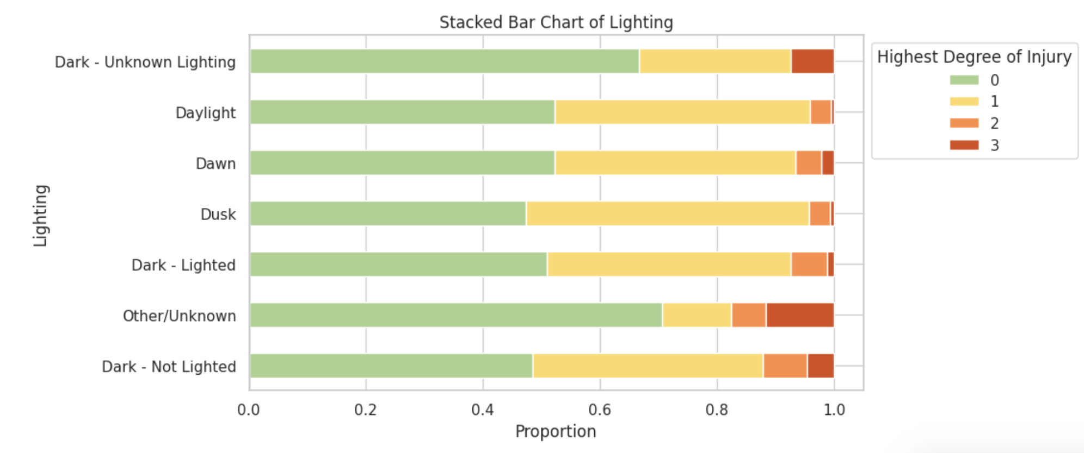
PROPORTIONAL BARCHARTS
Lighting: Dark, unlit roads resulted in the highest average degree of injury.

Slide 19
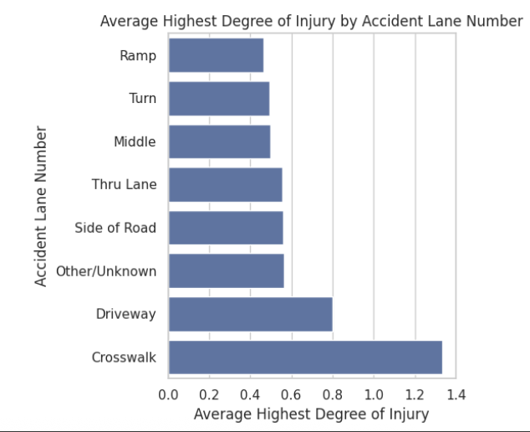
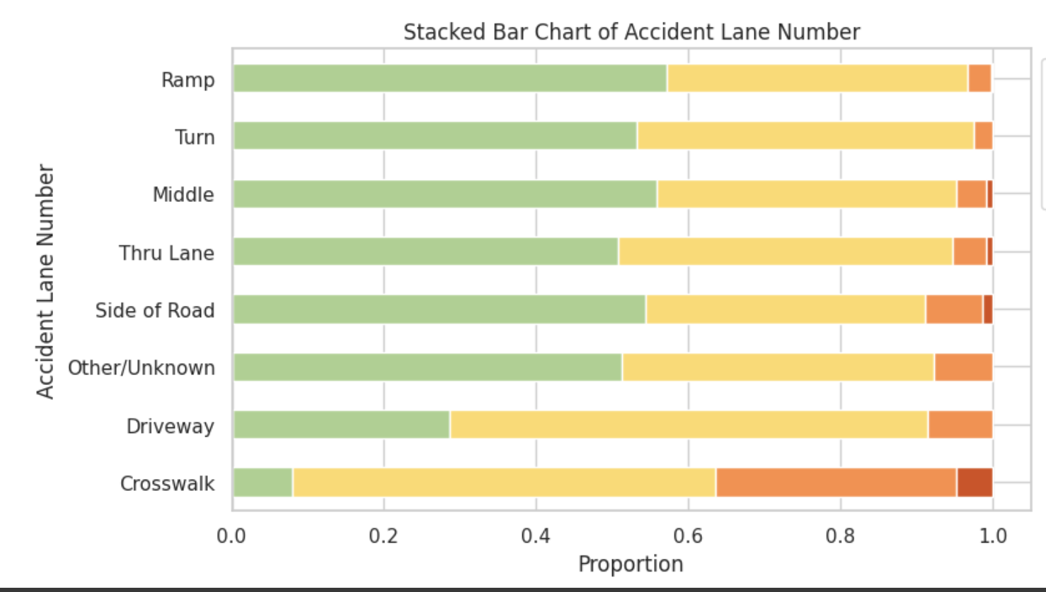
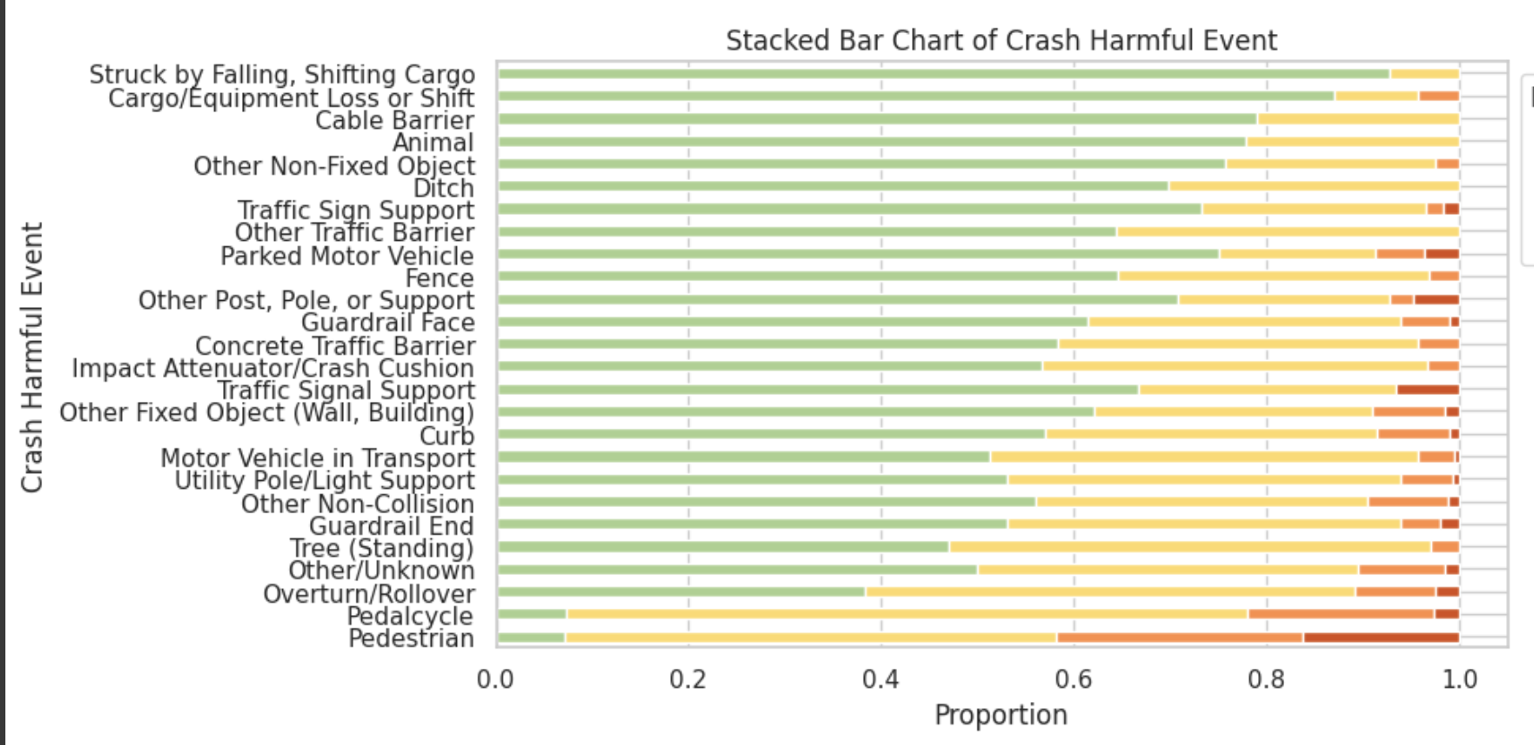
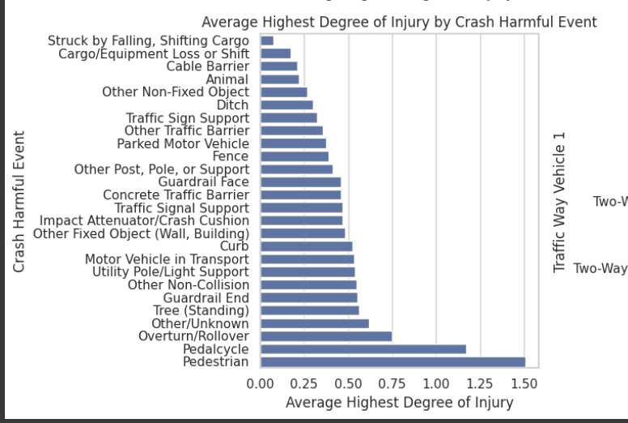
PROPORTIONAL BARCHARTS
Accident Lane and Crash Harmful Event: Accidents involving pedestrians and crosswalks resulted in the highest average degree of injury.

Slide 20
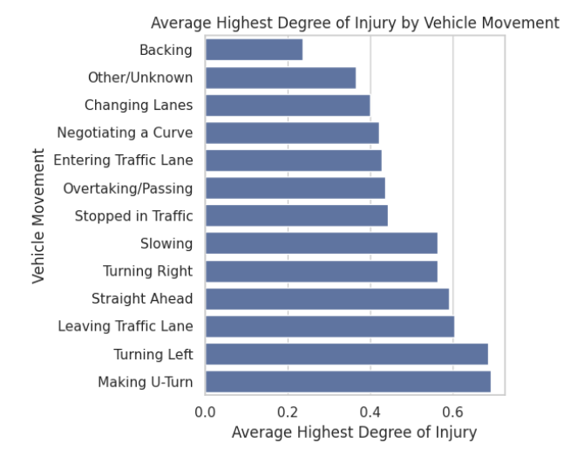
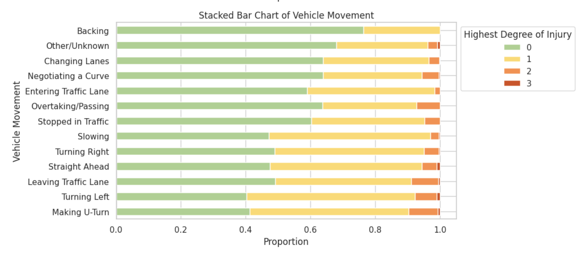
PROPORTIONAL BARCHARTS
Vehicle Movement: Turning left and making a U-turn resulted in the highest average degree of injury.

Slide 21
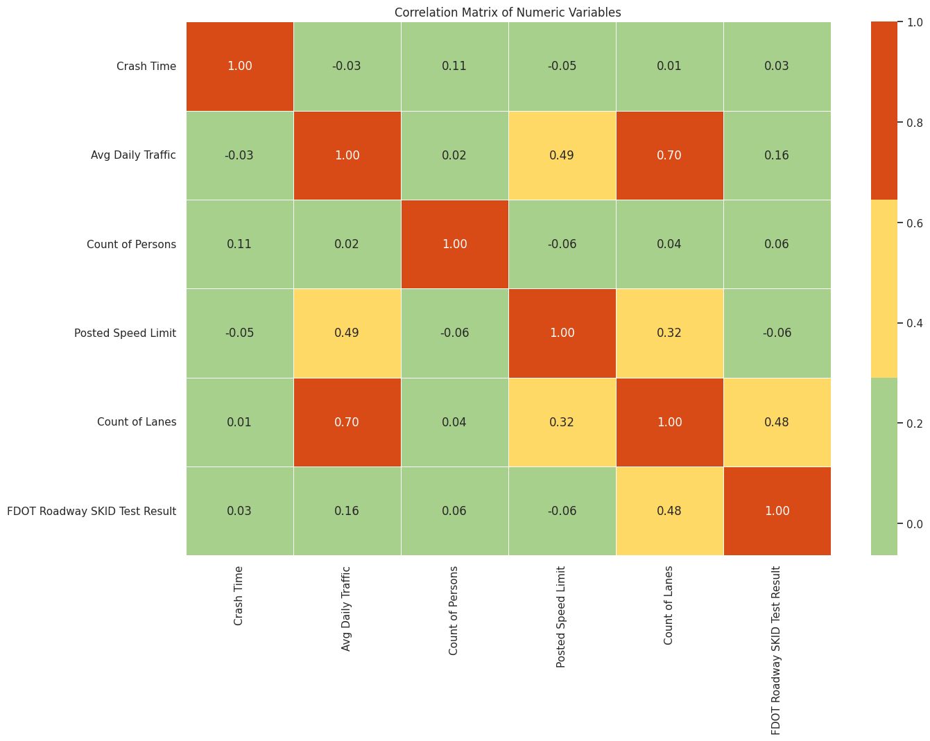
CORRELATION MATRIX
We also graphed a correlation matrix for the numerical variables.
Posted Speed Limit and Average Daily Traffic, and Count of Lanes and FDOT Roadway SKID Test Result both have moderate correlation.
Count of Lanes and Average Daily Traffic have high correlation.

Slide 22
MODELING

Slide 23
SPOT-CHECKING
We began our modeling process by spot-checking a few models with our 20 selected features.
This helped us identify the best performing models and refinements to make moving forward.

Slide 24
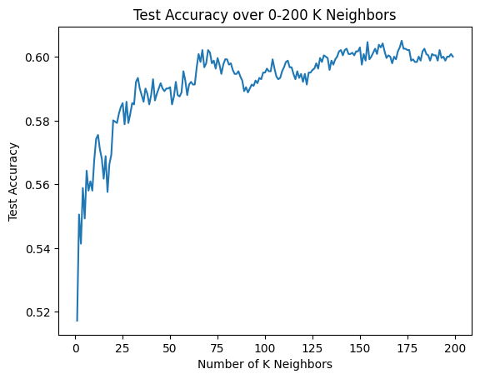
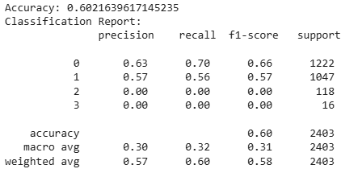
K-NEAREST NEIGHBORS
The initial plotting of KNN created middling results.
The K was selected by fitting the model for Ks between 0 to 200 and choosing the initial peak.
In this case, K = 67 was chosen.
While the overall accuracy is okay at 60%, classes 2 and 3 are not being classified due to their class imbalance.
We do not want these important accidents to be misclassified.

Slide 25
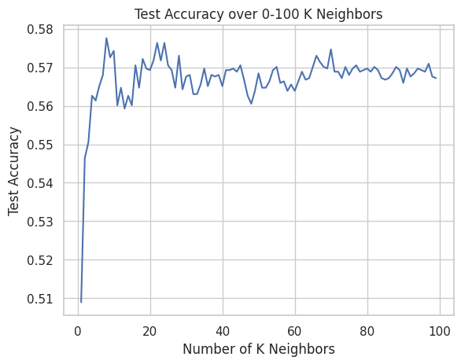
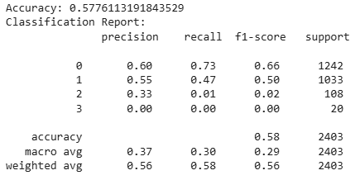
K-NEAREST NEIGHBORS
We made a second attempt using data stratification when splitting the train and test data.
This ensures the minority classes are properly represented.
Overall accuracy decreased, but we started classifying some of class 2.
Better, but model is still not classifying class 3 and the overall scoring was slightly worse.

Slide 26
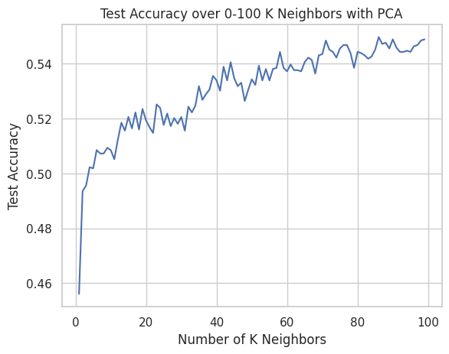
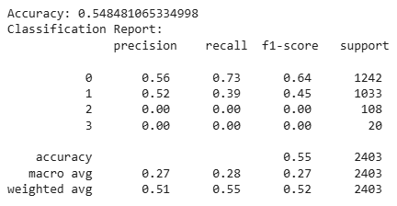
K-NEAREST NEIGHBORS
For a third attempt we used the stratified data with PCA.
Since KNN suffers from the curse of dimensionality, we wanted to see if using PCA to condense the data into two components would help.
Unfortunately, the results were overall worse from the second attempt.
It seems the condensing of the data caused class 2 to once again not be classified.

Slide 27
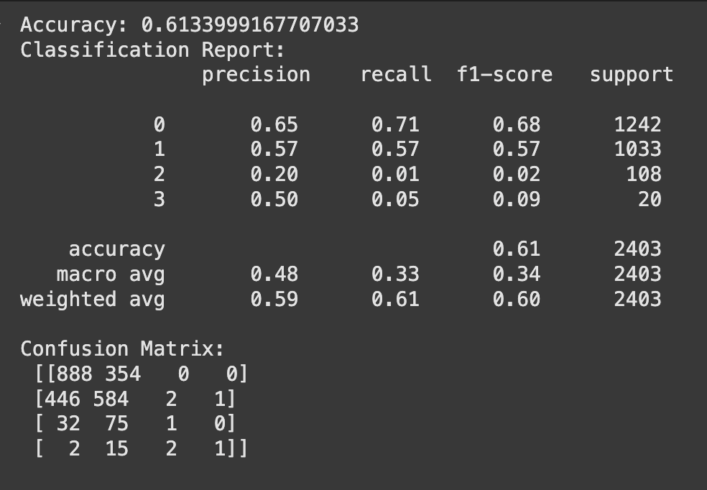
LOGISTIC REGRESSION
Model has moderate overall performance with an accuracy of 61.3% and a weighted F1-score of 0.60
Classification report shows a class imbalance where classes 0 and 1 did well but 2 and 3 did poorly (F1 Scores)
Confusion matrix shows that the most misclassifications involve classes 2 and 3 being predicted as class 0 or 1
The imbalance significantly skews the data (macro-average F1-score), showing the need for oversampling techniques like SMOTE to improve the model’s ability to detect minority classes

Slide 28
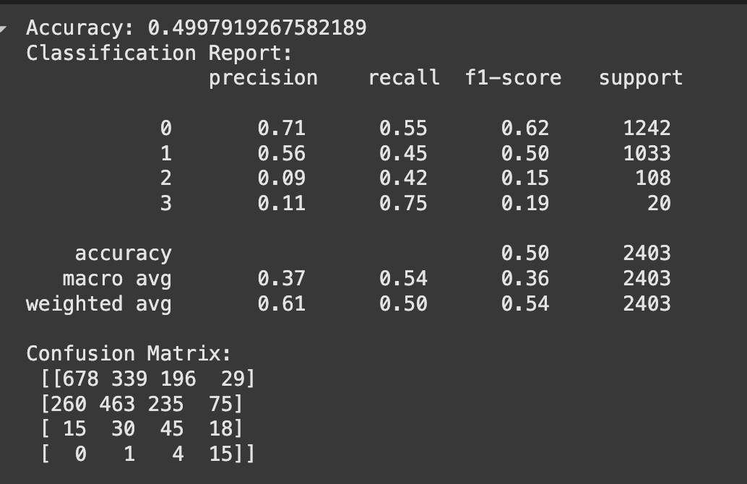
LOGISTIC REGRESSION AFTER SMOTE
Accuracy decreased to 49.99%- model has better balance in recall across all classes, particularly minority classes
Class 2 and 3’s increase in recall- model is now better at detecting minority classes
Increased accuracy at cost of precision, especially for classes 2 and 3, which have very low precision (0.09 and 0.11), suggesting many false positives
Macro-average recall rose to 0.54 from 0.33-confirms improved sensitivity across classes but the low precision score also reflects trade-off in precision

Slide 29
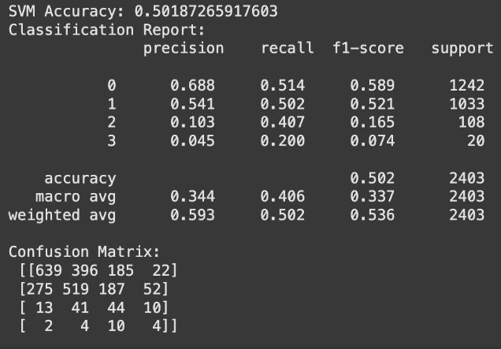
SVM
Used SMOTE to address class
imbalance
Overall accuracy of 50% which is
slightly lower than some other models
Model improved recall for the
minority classes (2 and 3) but it had
low precision.
Potential for detecting severe outcomes, but future work should focus on tuning hyperparameters and exploring class-weighted SVMs to improve performance

Slide 30
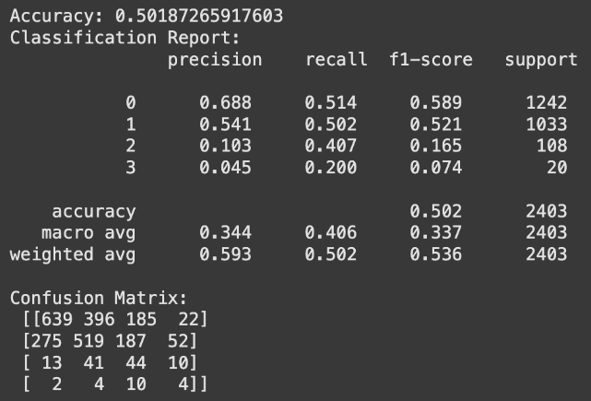
SVM
Used class weights
Accuracy stayed similar
Recall for class 2 slightly
decreased (0.41 → 0.35)
Precision for class 2
improved (0.10 → 0.17), reducing
false positives
Class 3 recall remained low in both cases (0.20 vs 0.15)
Class-weighted SVM had better balance of precision/recall for minority classes
Overall there was a trade-off between sensitivity (SMOTE) and precision (weights)

Slide 31
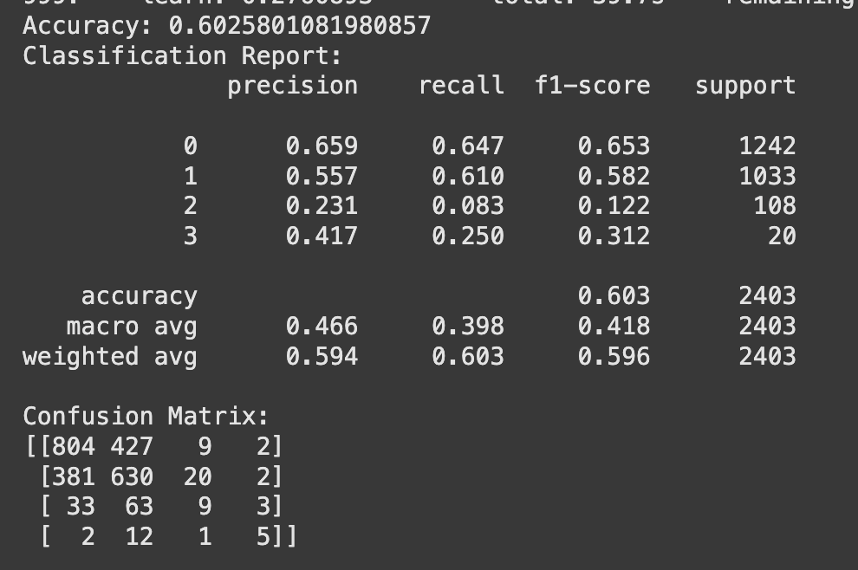
BOOSTING
Boosting generally performs better for imbalanced learning.
We first explored CatBoost since our data has many categorical features.
Before any optimization, CatBoost did the best job balancing overall accuracy with correct predictions for class 2 and 3.
We’ll focus on optimizing boosting algorithms moving forward

Slide 32
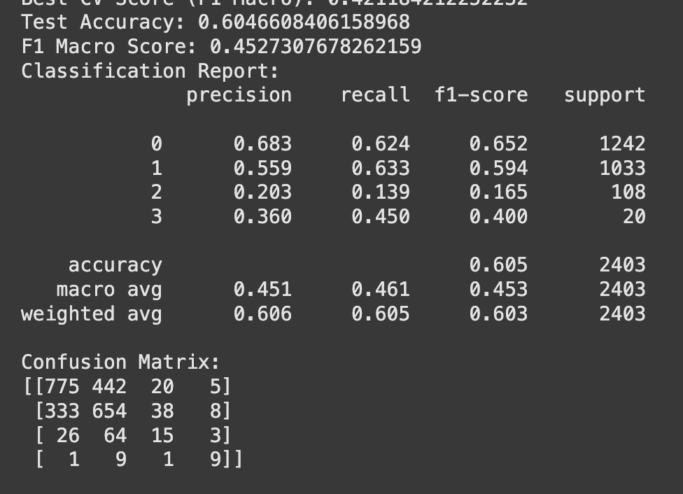
BOOSTING
Cross-validation to fine tune hyperparameters - F1 Score
Slight improvements in predicting classes 2 and 3
Model has hardest time distinguishing class 2

Slide 33
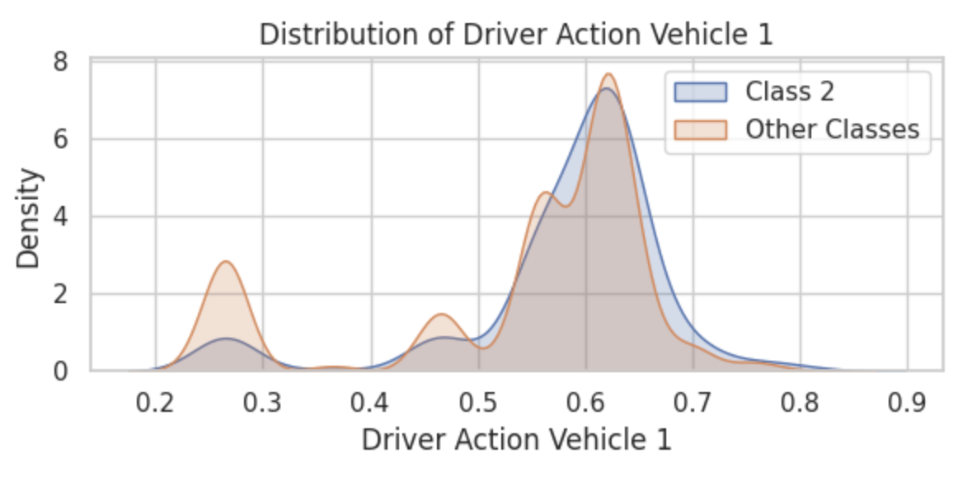
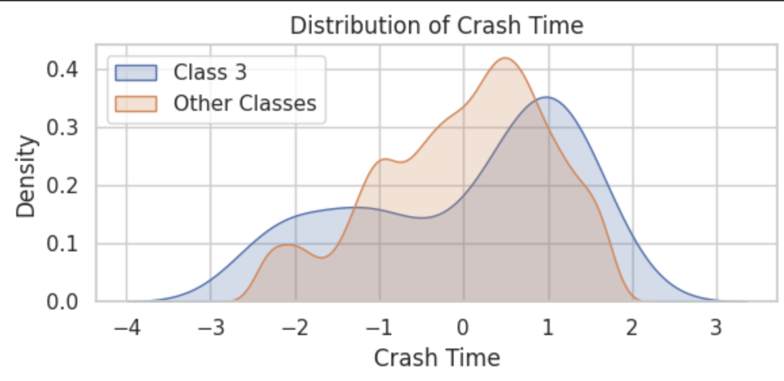
NOT ENOUGH SEPARATION
Class 2 (major injury) has minimal separation from the other classes for any feature in our dataset
Likely not possible for a model to accurately predict this class since there is nothing that distinguishes it
Solution would have to be a different project setup - not separating major injuries into their own class
Class 3 has some minor separation, such as how the density peaks at a slightly higher crash time - why class 3 has better results than 2

Slide 34
CONCLUSION
Overall due to class imbalance and lack of separation between features - No conclusive factors to predict specific injury outcomes
Injury/No Injury predictions perform decent, but classifying the injuries into minor, major, and fatality is a struggle - maybe this is more suited for binary classification
After SMOTE - Models are better balanced but less precise and therefore still inconclusive
Without more balanced and or precise data we can only infer based on common sense and basic data features the reasons for majority of vehicle accidents-Alcohol/Drugs Involved and possibly Lighting variables are clear reasons for higher accident severity

Slide 35
FUTURE STUDIES
If we were to do this again in the future, we would need a new dataset or a new project approach, such a simpler injury/no injury classifier
We’d need to collect data from a different source that included new, more predictive features about car accident injury level.
Many possibly relevant features weren’t recorded, like make/model of vehicle or exact demographics of driver

